Slide 1
UX Design Course
Telerik Academy
1 October 2015

Slide 2

Vasil Yordanov
Senior UX Designer at Telerik, A Progress Company
@yordanov

Slide 3
UX intro

Slide 4
Design Disruptors Trailer
- A documentary from InVision (Vimeo video)

Slide 5
Design?

Slide 6
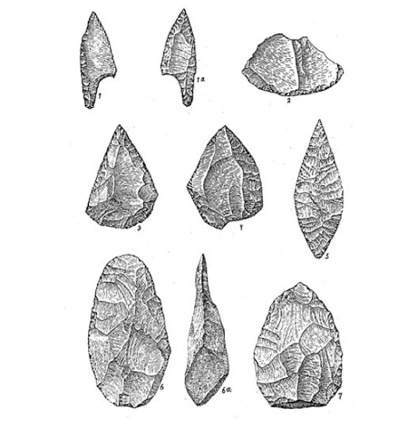
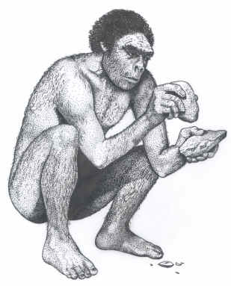

Slide 7
A solution in the form of a process or tool, that helps us achieve a goal or solve a problem in a particular moment.

Slide 8
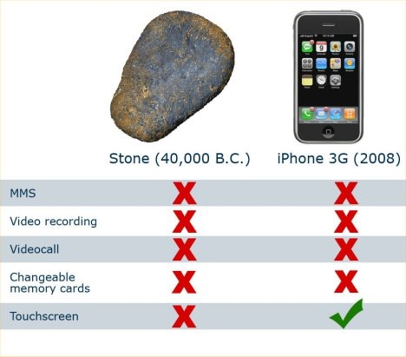

Slide 9
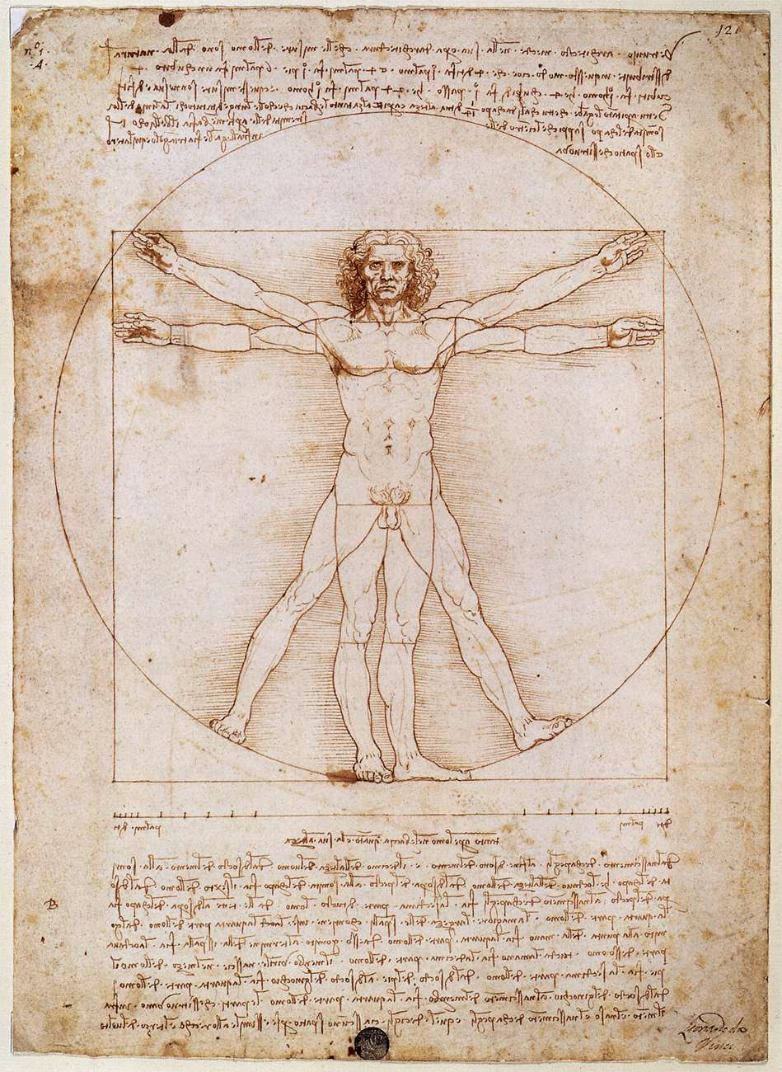

Slide 10
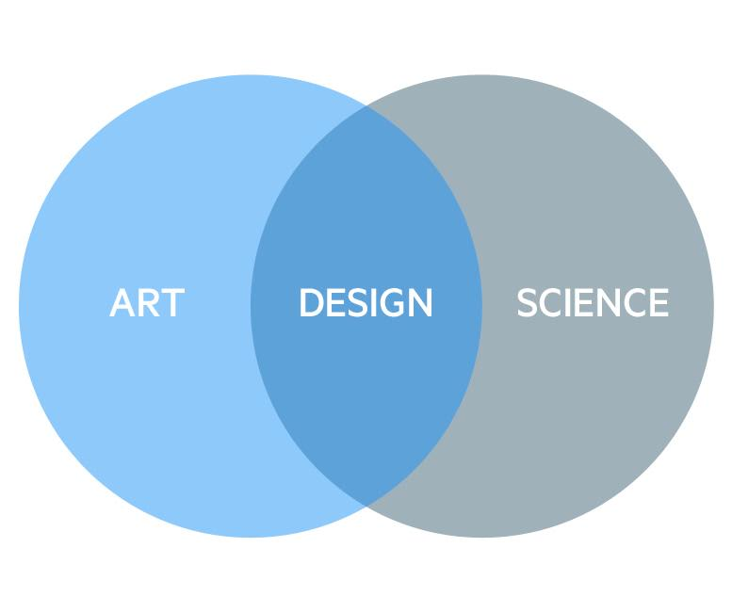

Slide 11
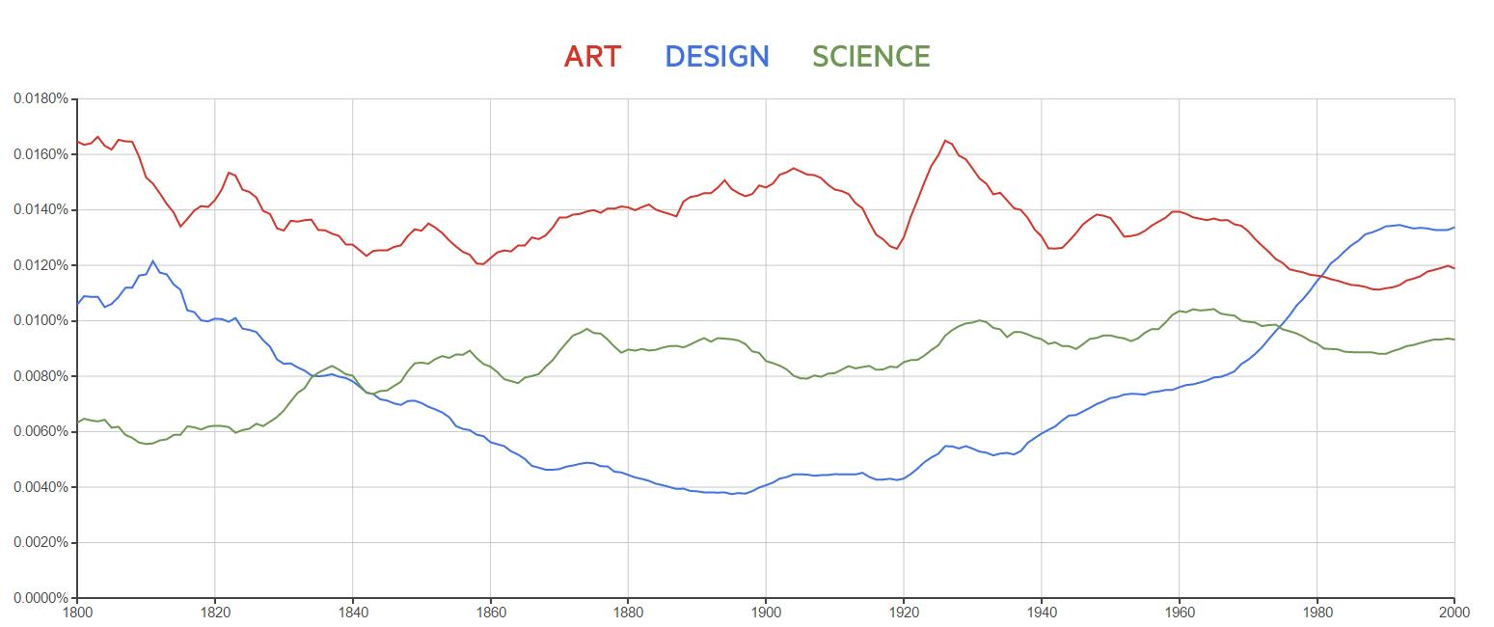
Source: books.google.com/ngrams/

Slide 12


Slide 13
Industrial Era

Slide 14
Users have
problems and needs.

Slide 15
Static Design

Slide 16
Source: books.google.com/ngrams/

Slide 17


Slide 18
Services Era

Slide 19
The user is the problem.

Slide 20
Dynamic Design

Slide 21
Why Design?

Slide 22
Source: books.google.com/ngrams/

Slide 23
Without design
we cannot make sense
of the world.

Slide 24
Why this Design?

Slide 25


Slide 26
Ideally, beauty and utility
are mutually generative.
- Paul Rand

Slide 27
Working With Rand
- Vimeo video

Slide 28


Slide 29
Indifference towards people and the reality in which they live is actually the one and only cardinal sin in design.
- Dieter Rams

Slide 30
Good Design:
Innovative
Makes a product useful
Aesthetic
Makes a Product Understandable
Unobtrusive
Honest
Long-lasting
Thorough, down to the last detail
Environmentally friendly
As little design as possible.

Slide 31
Dieter Rams'
Principles of Good Design
- Vimeo video

Slide 32
How?

Slide 33
User Interface Consistency
vs.
User Experience

Slide 34
Yes, I’m a button!

Slide 35
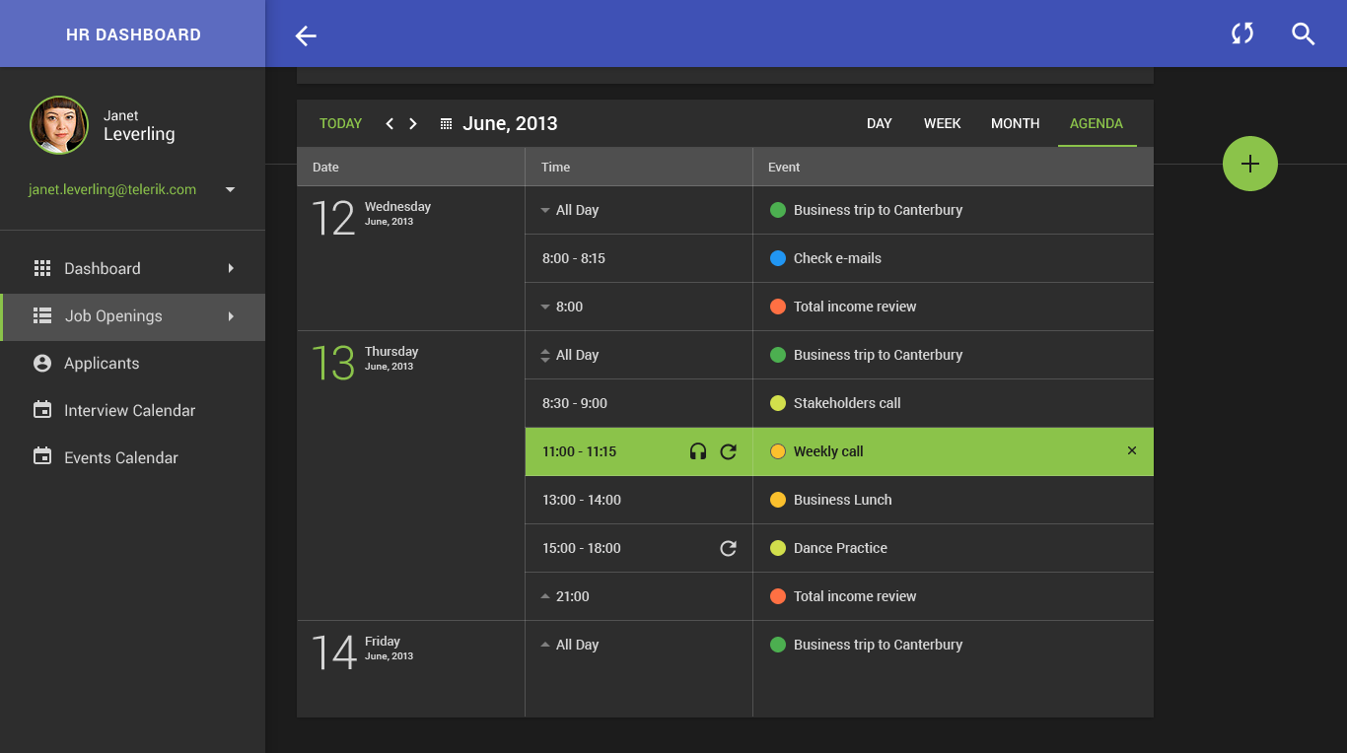

Slide 36
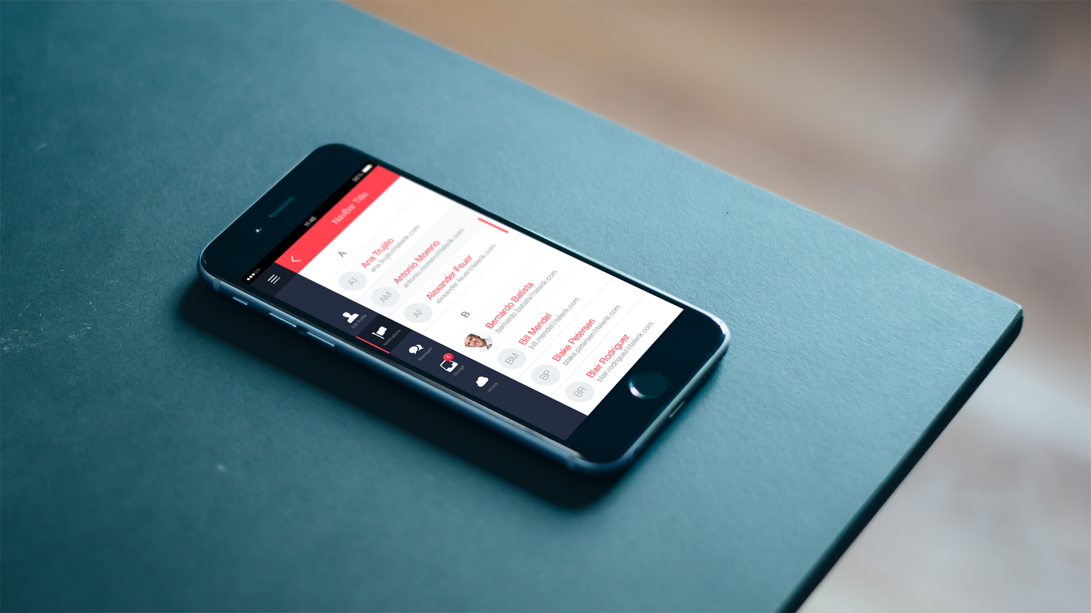

Slide 37

Any Browser
Any Device
Any Location

Slide 38
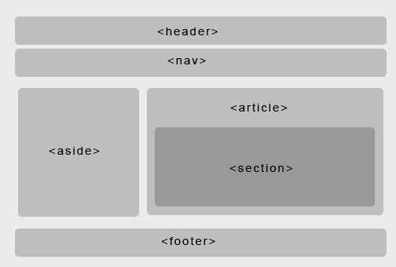
Organize

Slide 39


Economize
or

Slide 40
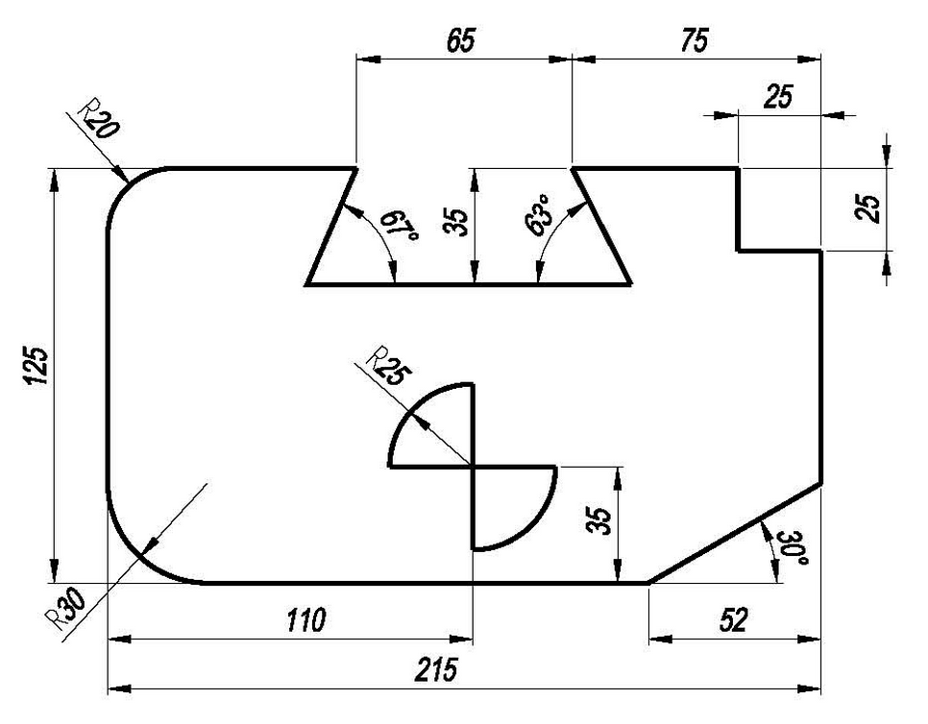
Communicate

Slide 41
Consistent Visuals and Interactivity
Consistent Organisation and Layout
Consistent Communication

Slide 42
Consistency
or …
Inconsistency

Slide 43
What is Consistency?
and
How to identify it?

Slide 44
Dimensions of Consistency

Slide 45
It’s me again :)

Slide 46
Layout
button {
position: absolute;
top: 100px;
left: 100px;
margin: 0;
}

Slide 47
Size
button {
width: 200px;
height: 32px;
line-height: 32px;
border-width: 2px;
}

Slide 48
Color and Texture
button {
background-color: blue;
background-image: button.png;
border-color: blue;
color: white;
}

Slide 49
Shape
button {
border-radius: 50%;
}

Slide 50
Typography
button {
font-family: Georgia;
font-size: 24px;
font-weight: normal;
text-transform: uppercase;
}

Slide 51
Animations and Transitions
button:hover {
transition: background 1s;
transform: rotate(180deg);
}

Slide 52
Properties
button {
position: absolute;
top: 100px;
left: 100px;
margin: 0;
width: 200px;
height: 32px;
line-height: 32px;
border-width: 2px;
border-radius: 50%;
border-color: blue;
background-color: blue;
background-image: button.png;
color: white;
font-family: Georgia;
font-size: 24px;
font-weight: normal;
text-transform: uppercase;
}

Slide 53
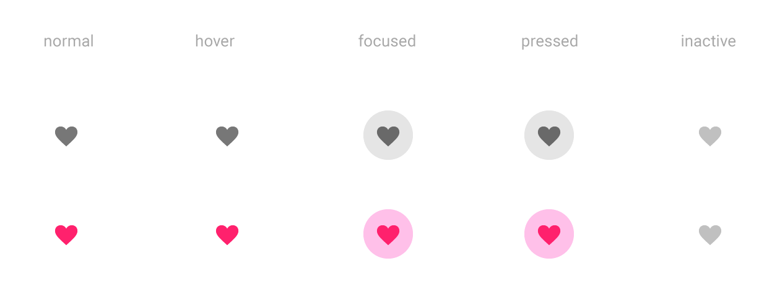
Interaction states
Source: http://www.google.com/design/spec/

Slide 54

~20
~5
≈ 100
x
properties
states
consistency dimensions

Slide 55
Internal Consistency

Slide 56
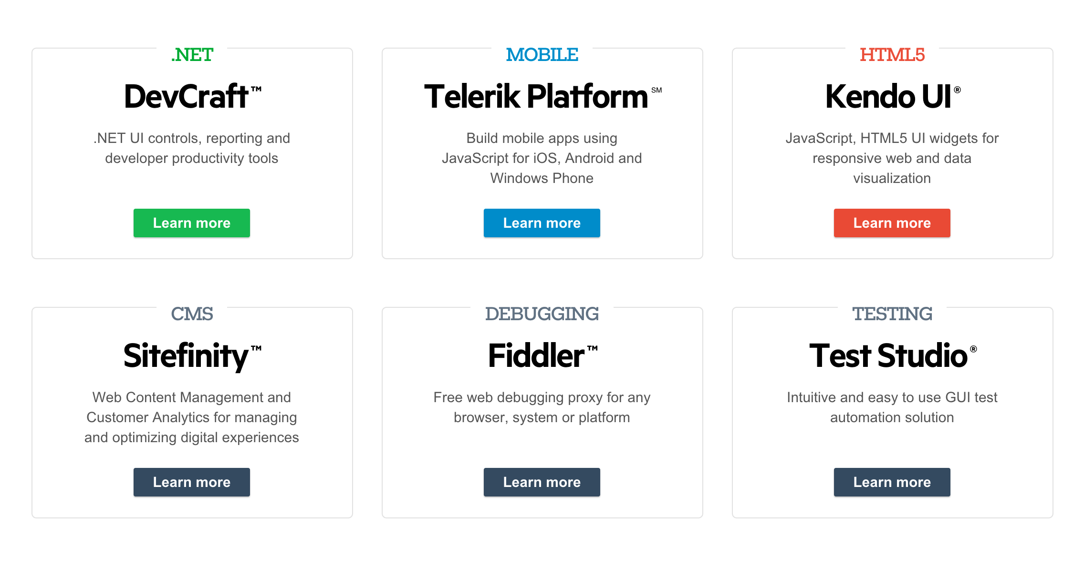
Source: http://www.telerik.com

Slide 57
External Consistency

Slide 58
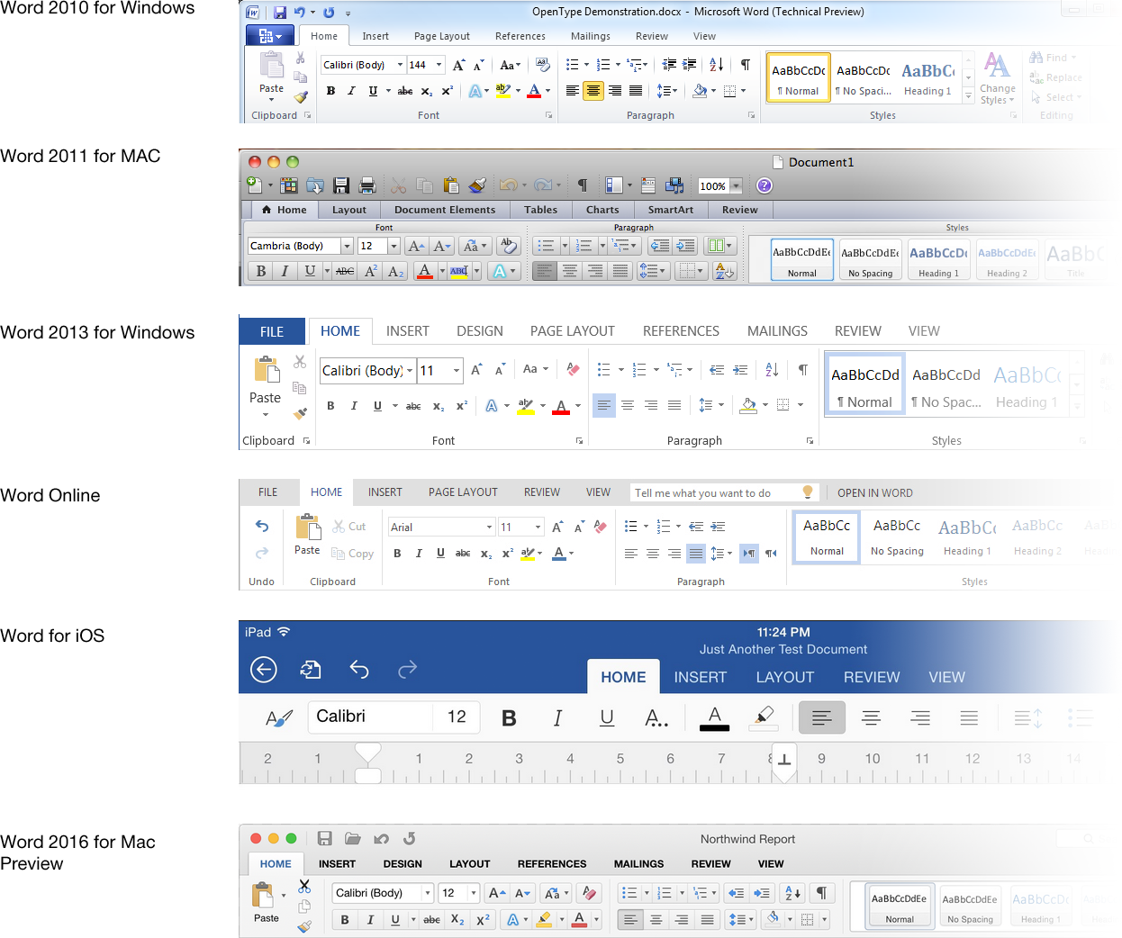

Slide 59


Slide 60
Real-World Consistency

Slide 61
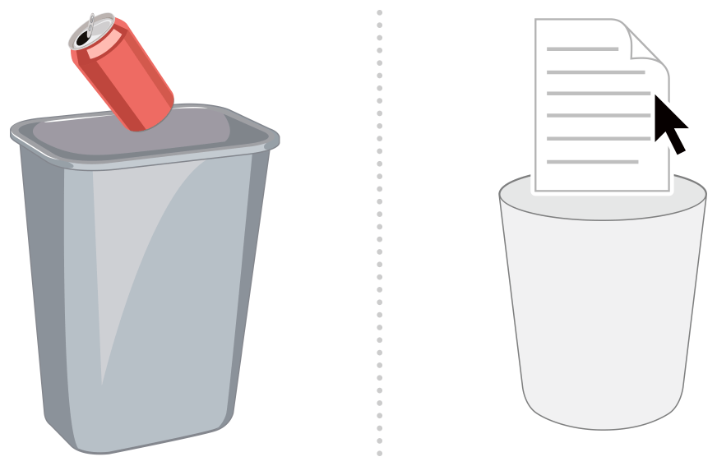
Source: OS X Human Interface Guidelines

Slide 62
Internal Consistency
External Consistency
Real-world Consistency

Slide 63
Consistency is not easy.

Slide 64

Avoid Surprises

Slide 65
Pay Attention to
Ease of Learning and
Ease of Use.

Slide 66
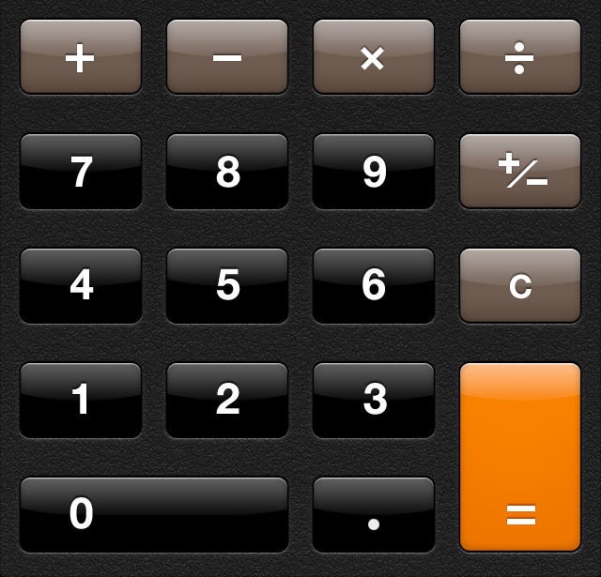
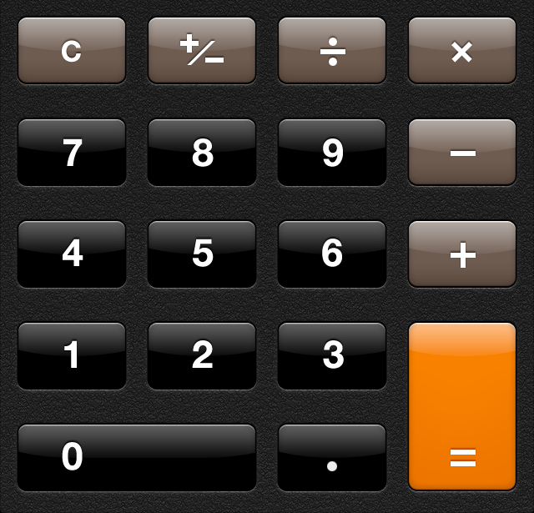
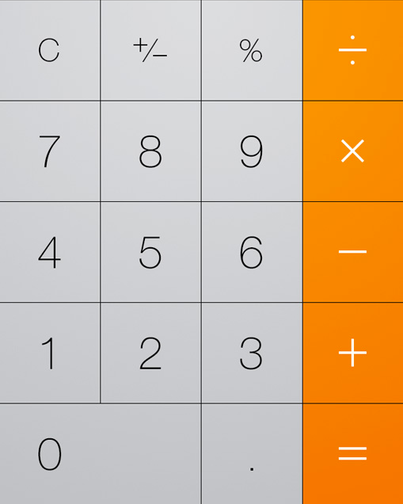

Slide 67
Use Design Patterns and
Best Practices.

Slide 68
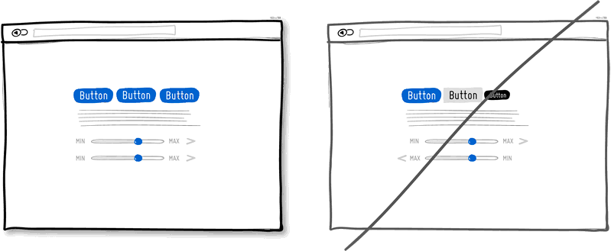
www.goodui.org

Slide 69
Break up your UI.

Slide 70
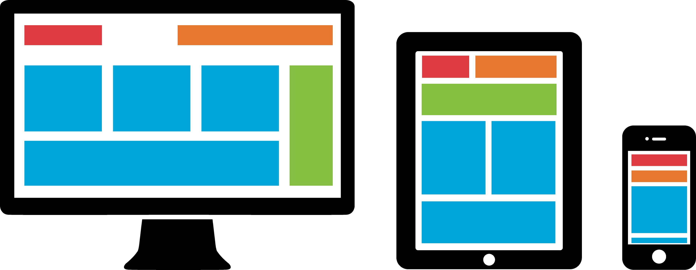

Slide 71
Create and Adhere to Guidelines.

Slide 72
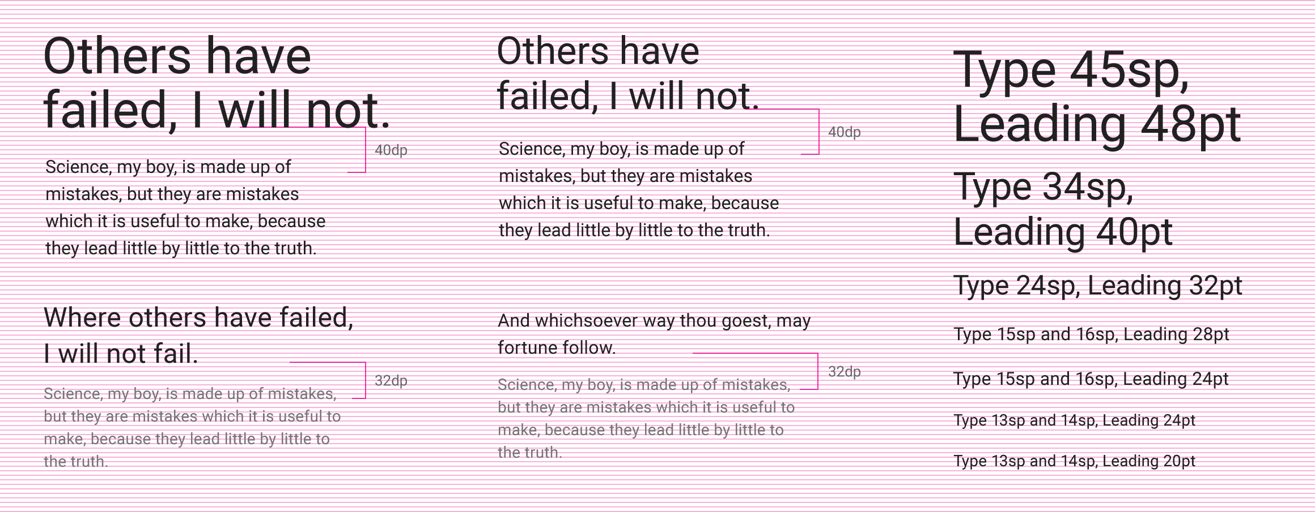
Source: Material Design Guidelines

Slide 73
- Surprises
- Ease of Learning vs. Ease of Use
- Design Patterns and Best Practices
- UI segmentation
- UI Guidelines

Slide 74
?
UX

Slide 75
User ?
UX

Slide 76
Product ?
UX

Slide 77






CONSISTENCY
STREAM
USER
PRODUCT

Slide 78

CONSISTENCY
STREAM
GOOD
UX
USER
PRODUCT

Slide 79


Slide 80
CONSISTENCY
STREAM
BAD
UX
USER
PRODUCT

Slide 81
CONSISTENCY
STREAM
BAD
UX
USER
PRODUCT

Slide 82
CONSISTENCY
STREAM
GOOD
UX
USER
PRODUCT

Slide 83
- Surprises
- Ease of Learning vs. Ease of Use
- Design Patterns and Best Practices
- UI segmentation
- UI Guidelines

Slide 84


Slide 85
Consistency is Your Friend!

Slide 86
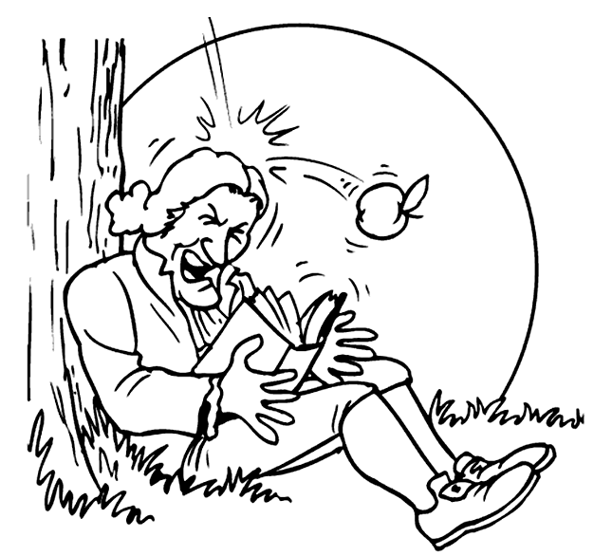

Slide 87

Thank You!
vasil.yordanov@telerik.com
@yordanov

